Slide 1

Criminal Just Process - Arrest

Slide 2
REMEMBER!!
  Criminal Justice Process includes every event from investigation to conviction and punishment
  At any time during this process:
  1) prosecutor may drop a case for lack of evidence
  2) defendant can negotiate a plea bargain
  3) judge can declare a mistrial if the jury is compromised in some way, shape, or form

Slide 3

Arresting a Suspect
Taking a person suspected of a crime into police custody
Remember: you can be arrested but not immediately booked for a crime (police usually have 24 hours to either book you or you must be released)
Det. Stabler had 24 hours to question Gordon Rickett (above) before Rickett was legally allowed to leave the precinct building

Slide 4
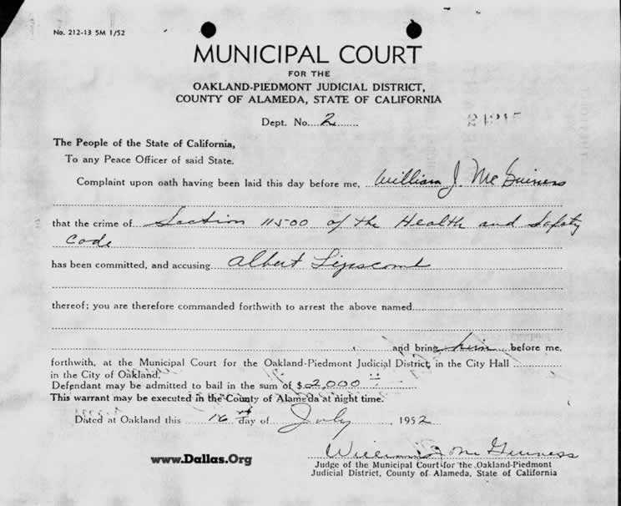
Arrest (cont’d)
By Warrant
1) court order commanding the person named be taken into custody
2) a formal complaint must be filed by the victim or police officer investigating the case
3) the facts and circumstances for the arrest must be sworn to as truthful before the warrant can be issued (known as an affidavit)
An actual arrest warrant issued in the state of California.

Slide 5
Arrest (cont’d)
By Probable Cause
1) PC = reasonable belief that a person has committed a crime
2) Can be established through eyewitnesses and confidential informants (CI must be reliable through past information/tips given to police)
Good tips = get out of jail. Bad tips = stay in jail.
A judge is often given the task of determining the reliability of a confidential informant for information provided

Slide 6

Probable Cause (cont’d)
3) Each officer must use their own judgment on determining if PC exists to arrest a suspect (cannot be simply a hunch that suspect committed a crime)

Slide 7
Probable Cause (cont’d)
An officer is permitted to question you at any time; but:
1) you are free to leave or refuse to answer questions if it is simply just talking
2) if you are asked to give identification and you run, you have given the officer PC to arrest you (this includes traffic stops)

Slide 8

Your Rights When You Are Arrested
You must be read the charges against you by the arresting officer
You must be told of your right to remain silent; if you waive this right, your statements can be used against you during your trial
You must be told of your right to legal aid and that you may have an attorney for free if you can’t afford one
The officer must confirm that you understand your rights before you are booked
How do they deal with people in custody that speak a different language?

Slide 9


Using Force To Arrest
Officers may use as much force as “reasonably necessary” during an arrest
Using Lethal Force
1. limited to incidents involving dangerous or threatening suspects (to both officer and/or public)
2. if too much force is used, suspect or family of suspect may press criminal charges or initiate a lawsuit against arresting officer
Why are officers sprayed with pepper spray and/or tazed in training?

